Slide 1
Customer Churn and Retention
Subha Yoganandan

Slide 2
What is churn analysis and why is it important?
Customer churn is the loss of customers or clients. Many companies often use customer attrition analysis as one of their key business metrics.
Churn analysis is used to understand how customers assess a particular product and help reduce the customer loss rate.
It is important to know a company’s retention rate because the cost of retaining an existing customer is sometimes less than acquiring a new one.
There may be different reasons for customer churn (e.g. cancelling/not renewing a subscription, switching to a competitor, etc).

Slide 3
What will this project achieve?
We will use machine learning models to predict if a customer will churn using various customer attributes
This outcome could be used to develop focused customer retention programs

Slide 4
What do we know about the data?
For this project we will be using the Telecommunications data (from IBM’s sample datasets). The dataset has details for 7000+ customers with information about:
Customer who left within the last month (churn)
Services that the customer had signed up for - phone, multiple lines, internet, online security, online backup, device protection, tech support, streaming TV and movies
Customer account details - tenure, contract, payment method, paperless billing, charges.
Demographic information - gender, age, partner, dependents

Slide 5
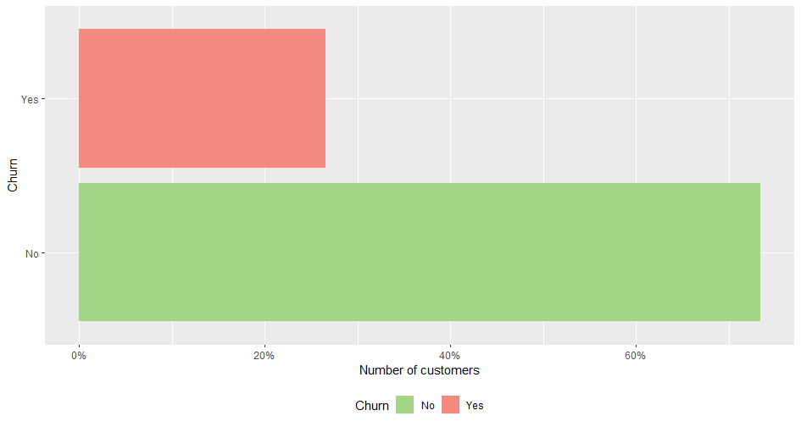
How many customers have churned?
Around 25% customers left the service in the last month

Slide 6
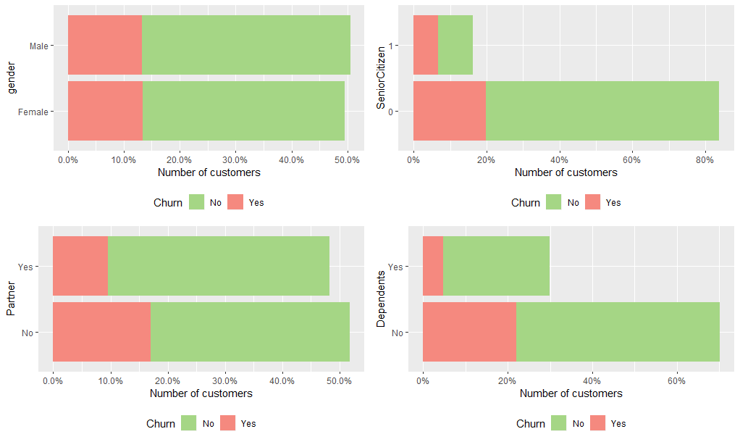
How do customer demographics affect churn?
Gender affects churn equally
Majority of senior citizens have higher churn rate
Customer who have partners and dependents have lower churn rate

Slide 7
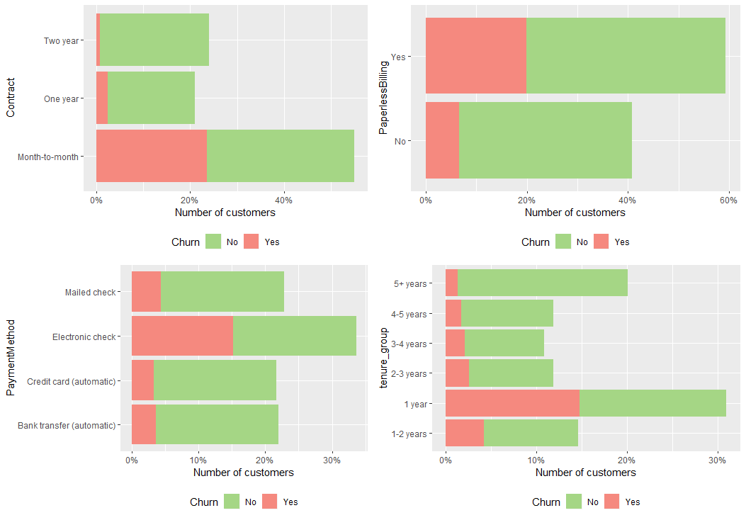
Do customer account information affect churn?
Many people use month on month contracts, so churn rate is prevalent.
Customers with paperless billing option, electronic check payments methods and 1 year contracts have higher churn rate.

Slide 8
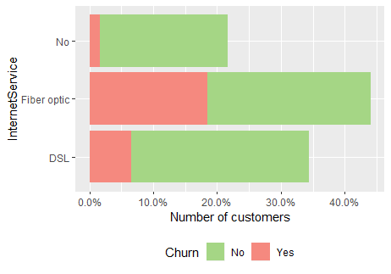
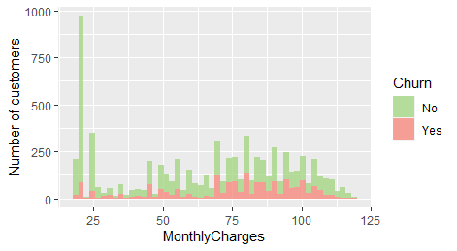
What about other patterns?
Churn is higher in fibre optic customers.
Customers with higher monthly charges have a higher churn rate

Slide 9
Modelling to predict churn
Using the knowledge we’ve gained through the exploratory analysis we have created 2 types of models to predict if a customer would churn.
A logistic regression model (uses probability of a certain event to model the outcome) and a decision tree (tree-like model of decisions and their possible conditions and outcomes) were used and both predicted churn 70-80% accurately.

Slide 10
Summary
Using the models we can learn that:
Customers who were on month to month contract, paperless billing and 1st year of tenure are more likely to churn.
Monthly charges and Internet Service are some of the other aspects the model uses to predict churn.
The next steps would be to identify customers likely to churn (using the model that we had created) and develop focused customer retention programs
Some examples of customer retention ideas include: loyalty programs, gather customer feedback and communication, proper onboarding within 1 year of tenure and setting customer expectations.
The code to the analysis is found in my github repository
https://github.com/subhayoga/customer-churn-analysis

